Slide 1

How We Built It: The Spam Classifier

Slide 2




Our 4-Phase Workflow
Acquisition
Cleaning
Vectorizing
Modeling
Collecting the Enron Corpus dataset.
Removing noise & normalizing text.
Converting words into math vectors.
Training & comparing 5 algorithms.

Slide 3
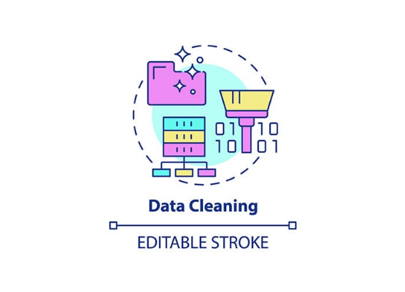
Step 1: Text Cleaning (The "How")
Turning Chaos into Data
Emails are messy. We applied a strict cleaning pipeline to ensure our models only see relevant information:
Lowercasing: To treat "WIN" and "win" the same.
Regex Filtering: Removing HTML tags & symbols.
Stop-Word Removal: Deleting useless words (is, the, in).

Slide 4
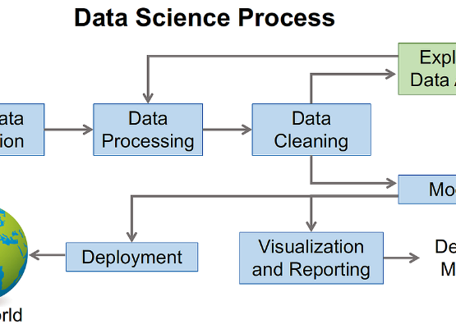

Step 2: Vectorization (TF-IDF)
Making Machines "Read"
Algorithms can't read text; they read numbers. We used TF-IDF (Term Frequency-Inverse Document Frequency):
"This method gives higher 'weight' to words that are rare across the whole dataset but frequent in a specific email (like 'Lottery' or 'Prize'), making spam easier to spot."

Slide 5

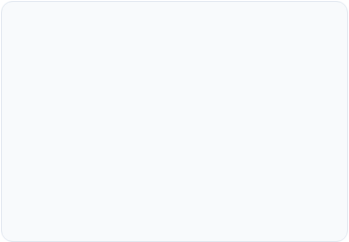
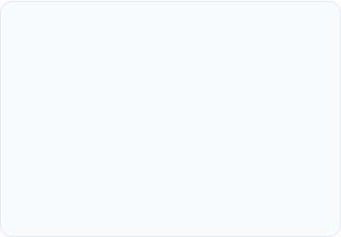





Step 3: Algorithm Implementation
We didn't just build one model; we built five to find the absolute best performer:
Naive Bayes
SVM
Logistic Reg.
The Baseline: Quick & based on probability.
The Border: Creating a clear margin between classes.
The Statistician: Predicting binary outcomes.
Random Forest
Decision Tree
The Crowd: Combining many trees for stability.
The Logic: Asking series of binary questions.

Slide 6
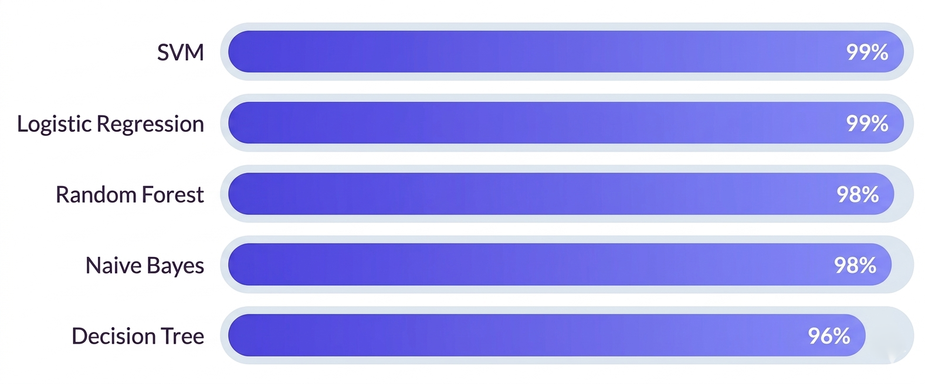
Step 4: Benchmarking Success
We evaluated every model using a "Test Set" (data the model has never seen before) to ensure real-world reliability:

Slide 7
Summary of Achievement
99%
What We Learned
Data Quality > Algorithm: Cleaning the Enron text was the most impactful step.
SVM Strength: SVM proved strongest for text as it handles high-dimensional vectors flawlessly.
PEAK PRECISION REACHED

Slide 8
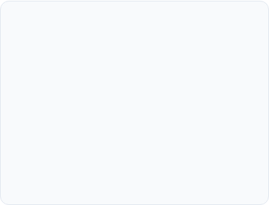
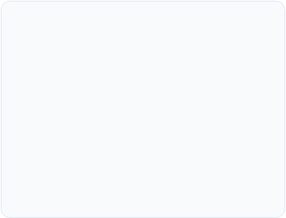
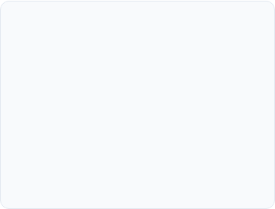





Meet the Team
Member 1
Member 2
Member 3
Member 4
Member 5
Tarek Mostafa
Abdallah omran
Abbas abdlrahman
Mahmoud Medhat
Noman Sami

Slide 9
Thank You
Project: Spam Email Classification Analysis

